Slide 1
Before you start
Mental health and emotional wellbeing
KS3
Home-learning lesson 1:
Promoting emotional wellbeing
To start, play this slideshow from beginning
All sides and content are © PSHE Association 2020
RESILIENCE | ASPIRATION | COMMUNITY | RESPONSIBILITY | CONFIDENCE

Slide 2
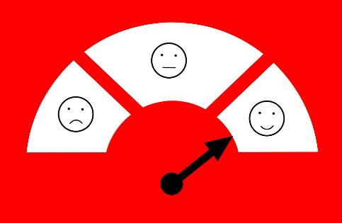
Home learning lesson 1:
Promoting emotional wellbeing
RESILIENCE | ASPIRATION | COMMUNITY | RESPONSIBILITY | CONFIDENCE

Slide 3
We are learning:
ways to promote emotional wellbeing
to build resilience and how to reframe disappointments and setbacks
We will be able to:
explain the factors that affect emotional wellbeing
identify ways to promote emotional wellbeing and build resilience
reframe and learn from disappointments and setbacks
RESILIENCE | ASPIRATION | COMMUNITY | RESPONSIBILITY | CONFIDENCE

Slide 4
Create an A-Z list of factors that can affect mental health and emotional wellbeing
(either positively or negatively)
A is for active lifestyles
B is for bullying
How many letters can you come up with an idea for?
C is for…
RESILIENCE | ASPIRATION | COMMUNITY | RESPONSIBILITY | CONFIDENCE

Slide 5
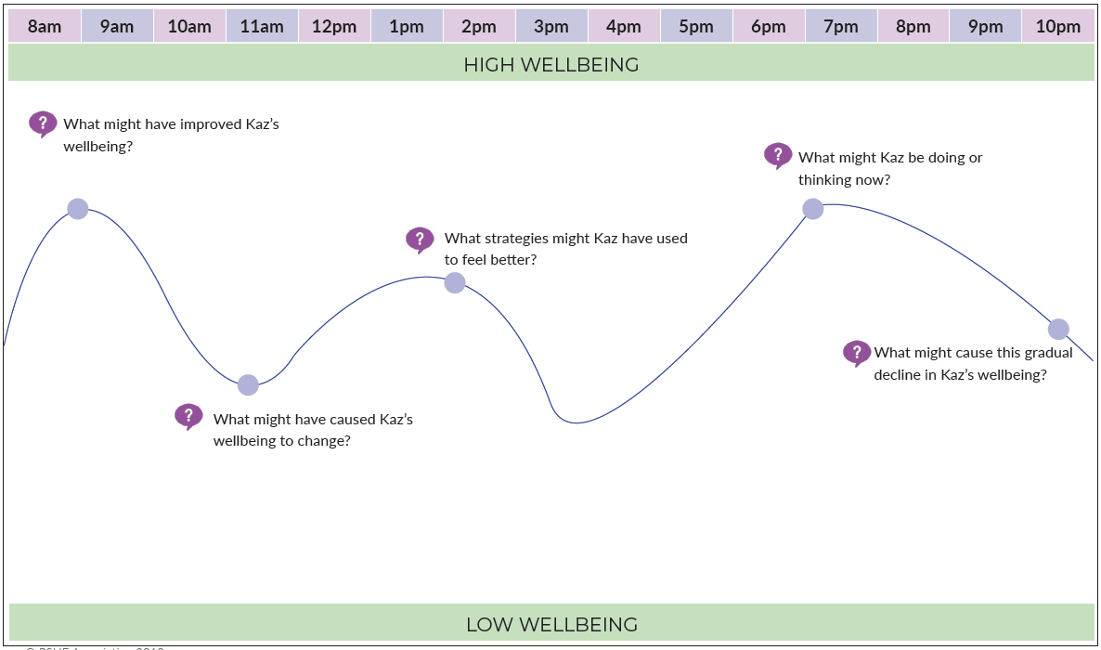
The chart shows how Kaz is feeling at different points in the day
Make notes on the questions below:
Stuck?
Click here for ideas
Ideas
Getting tired
Playing sport
Having detention
Time outside
Seeing friends
Positive thinking
A difficult lesson
Eating a healthy meal
Overcoming a setback
Having an argument
Checking social media
Playing a favourite game
Being proud of an achievement
RESILIENCE | ASPIRATION | COMMUNITY | RESPONSIBILITY | CONFIDENCE

Slide 6
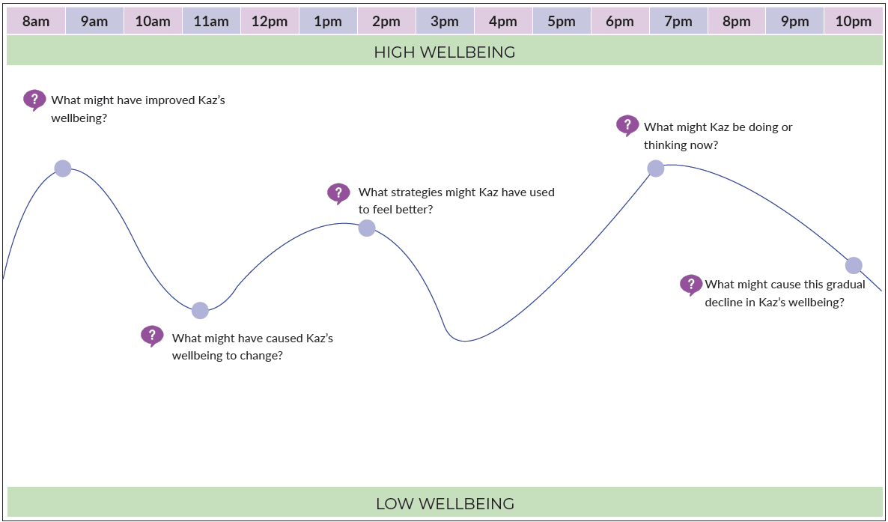
Kaz might be spending some time outside
Kaz might have had a difficult lesson
Kaz might be gradually feeling more tired
Kaz might have eaten a healthy breakfast
Here are some possible reasons for how Kaz was feeling. Did you think of any others?
Kaz might have taken part in a favourite hobby over lunch
RESILIENCE | ASPIRATION | COMMUNITY | RESPONSIBILITY | CONFIDENCE

Slide 7
Key points about wellbeing
It is typical and expected for emotional wellbeing to fluctuate throughout the day or over several days.
A key element of having positive emotional wellbeing is knowing how to bounce back from setbacks, or lift mood again when things are difficult.
Sometimes it can be hard to lift mood and this is when a person might need to ask for help.
RESILIENCE | ASPIRATION | COMMUNITY | RESPONSIBILITY | CONFIDENCE

Slide 8
Watch the clip of Michael Jordan talking about failure
Michael Jordan is a famous USA basketball player who many consider to have been the greatest basketball player of all time.
Michael Jordan says:
“I’ve failed over and over again in my life – this is why I succeed.”
What does he mean by this? Click to reveal the answer
Michael Jordan means that his failures are something that naturally occur alongside his successes. They are part of a process in which he continues to improve. To him, a failure is not the end but is a step in his journey. This means that after a failure he continues to practise and learn. Because he learns from his mistakes he has become more successful overall.
RESILIENCE | ASPIRATION | COMMUNITY | RESPONSIBILITY | CONFIDENCE

Slide 9
What is the meaning of resilience?
Write your own definition of the word resilience. Are there any words that you think are similar in meaning?
Click here for a definition
Resilience describes the result of a process through which someone recovers from difficulties; adapts and overcomes risks and challenges; perseveres and ‘bounces back’ from setbacks.
RESILIENCE | ASPIRATION | COMMUNITY | RESPONSIBILITY | CONFIDENCE

Slide 10
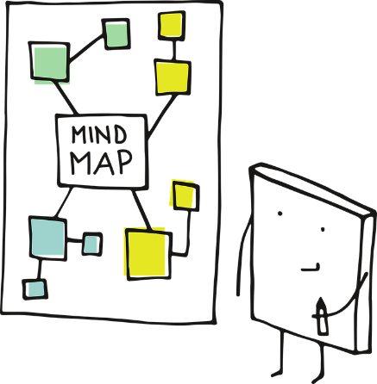
Create a mind map of ways people can help themselves to become more resilient in their daily lives
Categories you could include in your mind map:
Things about a person’s character
Things to do with family or friends
Things a person can do themselves
Stuck?
Click here for ideas
If you want to challenge yourself, choose three items on your mind map that you think would be easiest for a person to do if they wanted to become more resilient.
RESILIENCE | ASPIRATION | COMMUNITY | RESPONSIBILITY | CONFIDENCE

Slide 11
Key points about building resilience
Working towards a goal
Keeping things in perspective
Keeping a positive outlook
Embracing change as a normal part of life
Helping others where possible
Techniques to build resilience
Embracing new challenges
Staying connected with friends and family
Focussing on what has gone well, strengths and accomplishments
Taking care of themselves physically and emotionally
Avoiding seeing disappointments and setbacks as failures or as problems that cannot be overcome
RESILIENCE | ASPIRATION | COMMUNITY | RESPONSIBILITY | CONFIDENCE

Slide 12
Additional techniques for supporting resilience
Techniques to support emotional wellbeing:
Journaling (writing about experiences, feelings and reflections on a regular basis)
Meditation
Techniques to support physical health and emotional wellbeing:
Healthy sleep routines
Regular exercise
Maintaining a healthy, balanced diet
RESILIENCE | ASPIRATION | COMMUNITY | RESPONSIBILITY | CONFIDENCE

Slide 13
Managing disappointments and setbacks
What day-to-day situations might cause disappointment or be seen as a setback?
Sort the cards from Resource 1 into piles:
Strategies to help prevent disappointments and setbacks (ie. What could be done beforehand to help stop them happening as often?)
Strategies to help manage disappointments and setbacks (ie. What could be done in the moment to deal with the situation more positively?)
Suggestions:
Not getting a particular mark on a test
Being let down by a friend
Seeing a negative comment on social media
Struggling with a new skill
Tip: If you are unable to print this, choose one colour for each ‘pile’ and change the colour of the font or background of the card.
RESILIENCE | ASPIRATION | COMMUNITY | RESPONSIBILITY | CONFIDENCE

Slide 14
Helpful strategies to reduce the impact of disappointments or setbacks
Activities such as journaling, listing positive qualities and experiences, or practising gratitude, can be regular habits which support a positive mindset.
Asking questions such as ‘how will this event be affecting my life in a week/month/year’s time?’ can help keep things in perspective.
Reframing disappointments and setbacks to create a more positive take on an event, and being proactive in resolving issues which are upsetting.
RESILIENCE | ASPIRATION | COMMUNITY | RESPONSIBILITY | CONFIDENCE

Slide 15
Unhelpful strategies
While we have looked at helpful strategies, there are some strategies that would be unhelpful and/or risky, such as:
Using drugs, including alcohol, to manage feelings
Shouting at, ganging up on and manipulating others are aggressive strategies which are likely to have unintended serious consequences.
Ignoring issues is a passive response which can lead to difficult situations continuing unnecessarily.
RESILIENCE | ASPIRATION | COMMUNITY | RESPONSIBILITY | CONFIDENCE

Slide 16
Revisit your A-Z from the start of the lesson.
✓Tick things which can have a positive impact on mental health
Add new ideas and reframe negatives where possible
A is for active lifestyles ✓
B is for bullying
C is for consideration of how failures help us to learn ✓
RESILIENCE | ASPIRATION | COMMUNITY | RESPONSIBILITY | CONFIDENCE

Slide 17
Further support
There are lots of places to get advice about emotional wellbeing, or to discuss feelings.
ChildLine:
www.childline.org.uk Phone: 0800 1111
Young Minds:
www.youngminds.org.uk
Samaritans:
www.samaritans.org Phone: 116 123
If you have questions or concerns about emotional wellbeing or mental health, you can always speak to your parent or carer, or contact a teacher in school for more advice and support.
RESILIENCE | ASPIRATION | COMMUNITY | RESPONSIBILITY | CONFIDENCE

Slide 18
More activities
Storylines
List characters or storylines from well-known programmes, films or recent news items that illustrate the following concepts:
keeping going when things are tough
having the confidence to do what they think is right
bouncing back from setbacks
seeing mistakes as opportunities to learn
adapting if a person does not succeed first time
Decision tree
Create a decision tree to illustrate consequences of acting in different ways.
Tara is upset she was not invited to an online group chat with her friends
Tara has a go at her friends for leaving her out and ignores them for a week
Tara asks her friends to message her if they have another group chat
Tara’s friends are upset and don’t invite her to the next group chat
Tara has a great evening catching up with her friends online
RESILIENCE | ASPIRATION | COMMUNITY | RESPONSIBILITY | CONFIDENCE

