Slide 1
Increasing Educational Provision – Y10
Stage 1 – Option Subjects
(Live Online Teaching – WC 15th June 2020)
Responding to government guidance

Slide 2
Live Online Teaching – Option Subjects
We will be using Microsoft Teams to offer live/audio teaching.
Teachers will screen share power-point/resources and follow the normal Maltby Academy Lesson Cycle to deliver the online live learning.
The timetable on the following slide identifies when these lessons will take place for option subjects.
A further increase to our provision will come WC 22nd June 2020 when we begin teaching core subjects onsite (Details to follow). When this begins there will be times when some students will be onsite having core lessons when their option subject lessons are being delivered online via Microsoft Teams. To ensure students always have access to every available lesson, the option subject lessons will be recorded so they are accessible at a later time/date. The lessons will appear in the news feed.
To ensure that the teaching is maximised in the 1 hour lessons, the ‘iZone’ (Independent/deliberate practice/tasks) will be set as work to complete outside of the live lesson and submit in the way that students have submitted work up to this point. Live lessons will run in the mornings and where students don’t do the subject being taught on that period, they should use this time to complete previously set work/iZones. Afternoons should also be used to complete work/iZones.

Slide 3
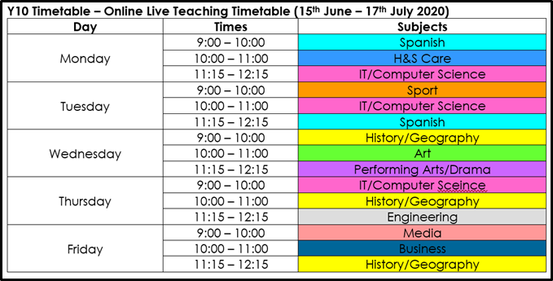
Online Live Teaching 15th June 2020 – All staff (Y10 Ebacc & Open)
* IT has been allocated more time to support the early completion of this qualification during Y11.

Slide 4
Microsoft Teams – Student Guide.

